Slide 1


Confusion of Innovations
Mainstream consumer perceptions and misperceptions of PEV technology
Jonn Axsen
Co-authors: Brad Langman,
Suzanne Goldberg
Sustainable Transportation
Research Team (START)
Simon Fraser University
Vancouver, Canada
January 11, 2017
Transportation
Research Board
Washington DC

Slide 2
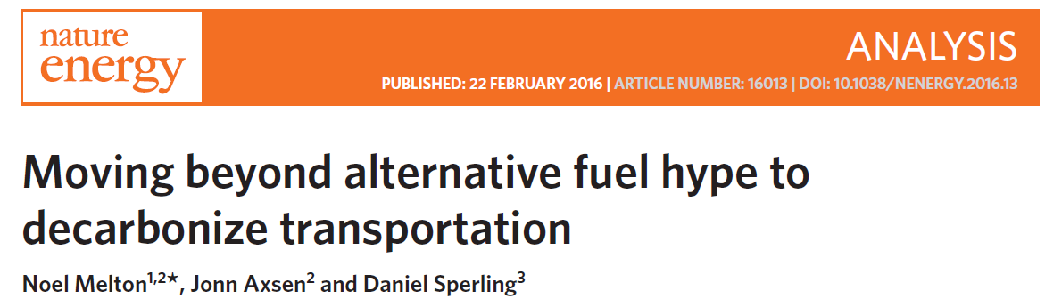
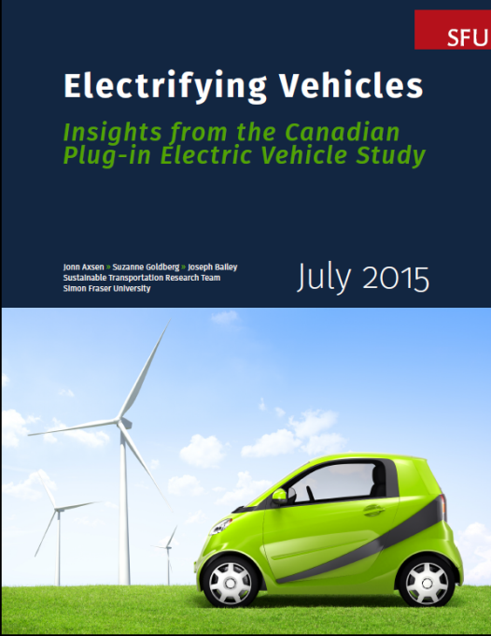
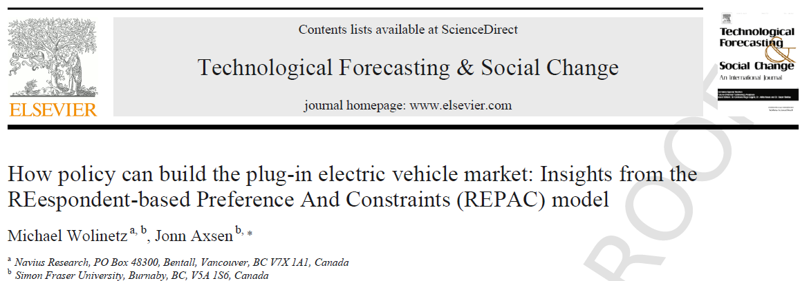
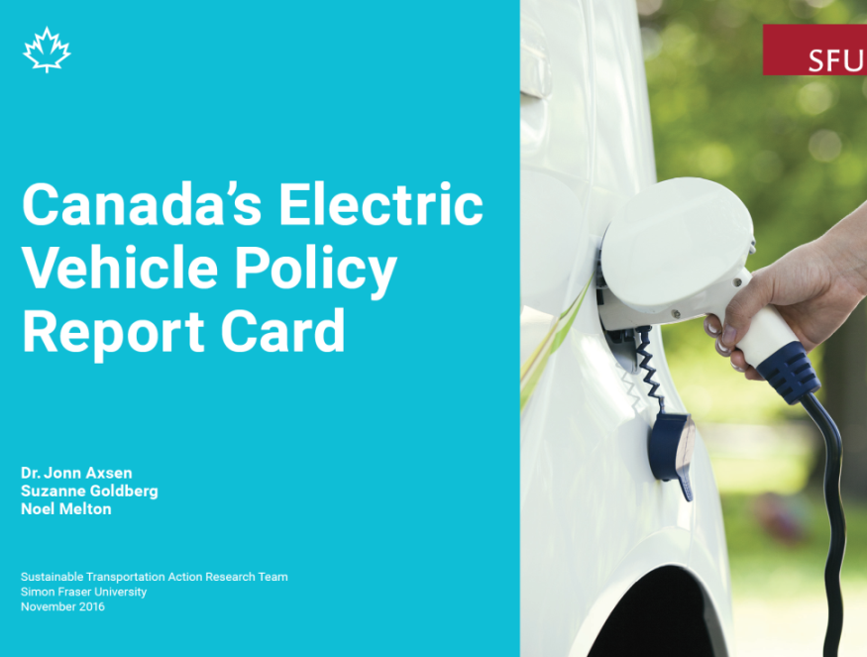
Sustainable
Transportation
Action Research
Team (START)

Slide 3
Perspectives on the consumer
The “Rational Actor”…. | The “Reflexive Participant”…
…has perfect information. | …might have little or no information
…has established preferences. | …might have unformed preferences
…has static preferences. | …can change preferences over time.
…can articulate those preferences. | …might have trouble communicating those preferences
The respondent:
awareness,
understanding,
perceptions,
preferences
Method:
Survey,
interview,
model,
analysis
Representation of respondent
Results,
interpretation,
Insights
Notes:
Utility controlled charging (UCC) could be an important method to control the timing of PEV charging to reduce environmental impacts, increase the use of renewable energy, and potentially reduce grid costs. We explore respondent acceptance of various UCC programs, finding that:
Among Mainstream (NVOS) respondents:
Awareness and understanding of electricity sources and the idea of UCC is very low.
Once explained, there is general openness to UCC programs, where probability of enrollment in such a program is higher with decreased electrical bills, increased access to renewable electricity, and increased “guaranteed minimum charge” or more charge each morning.
There is significant heterogeneity among respondent that are “Pro-UCC” (79%), where 34% are motivated by guaranteed minimum charge or more charge, 28% are motivated by cost savings, and 17% are motivated by increased renewable electricity.
Interviews indicate that some see linking PEVs to green electricity as “natural,” but there is concern regarding loss of control and lack of trust in the utility.
Among PEV Pioneer (PEVOS) respondents:
UCC acceptance is much higher relative to NVOS respondents, where PEVOS respondents are willing to pay 50% more for guaranteed minimum charge, and 4 times more for increased renewables
Two-thirds of respondents are clearly “Pro-UCC”; the remaining third places a lower value on UCC and is much more sensitive to decreases in guaranteed minimum charge.
Interviews indicate that motives for UCC enrollment are primarily related to supporting the environment (renewables) or supporting technology development.

Slide 4
The Canadian Plug-in Electric Vehicle Study (CPEVS)
2012-2016

Slide 5
A perspective on the PEV market:
Now and future
PEV “Pioneers”
(n = 126)
Potential
“Early Mainstream”
PEV buyers
(n = 1754)
New vehicle buyers
Source:
Axsen et al. (2015),
Electrifying Vehicles
Passenger Vehicle Owners
Notes:
Introduce BC PEVOS and CPEVS or visualize it here. Talk about the CPEVS
--- Brief synopsis of the CPEVS
Survey = 538, 40% (215) were EM; 60% (323) were other
-- EV’s represent less than 1% of new vehicle sales. New vehicle sales represent X% of total register personal vehicles which is over 2.5 million.

Slide 6
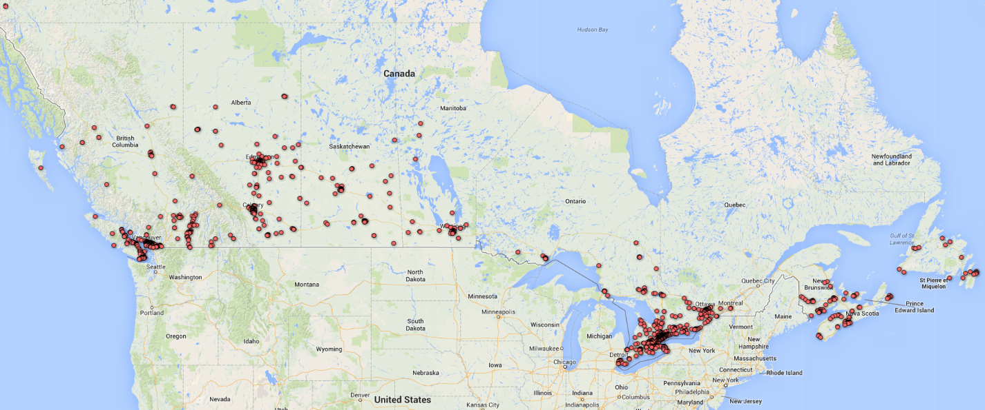
Canadian “Mainstream” Survey (n = 1754), representative of new vehicle buying households
Source: Axsen et al. (2015), Electrifying Vehicles

Slide 7
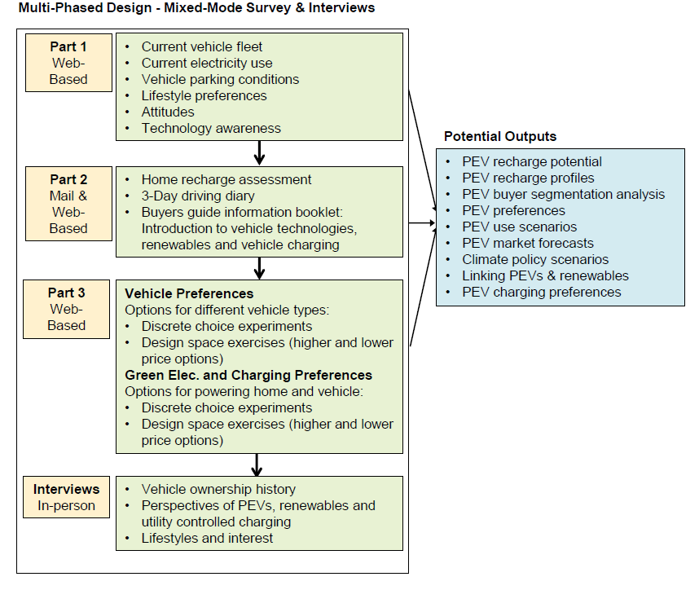
The reflexive CPEVS approach
Source: Axsen et al. (2015), Electrifying Vehicles

Slide 8
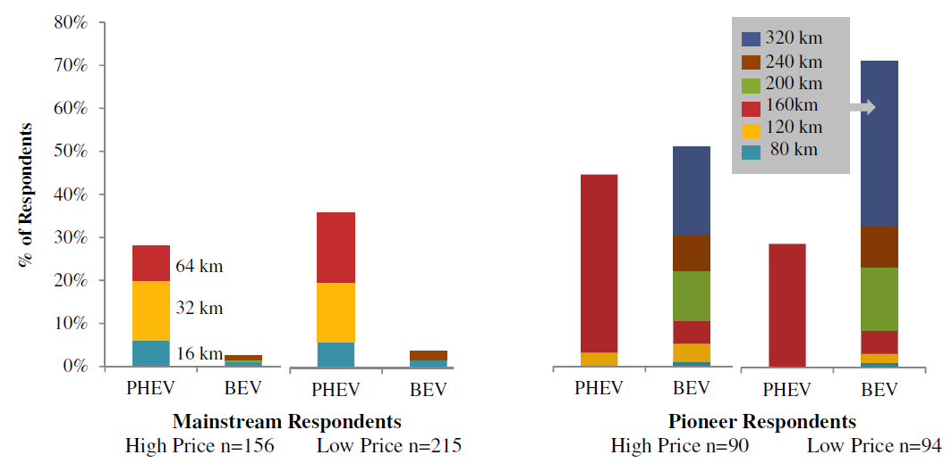
Mainstream buyers are more attracted to PHEVs, not so much BEVs
Source: Axsen, Goldberg and Bailey (2016), Transportation Research Part D

Slide 9
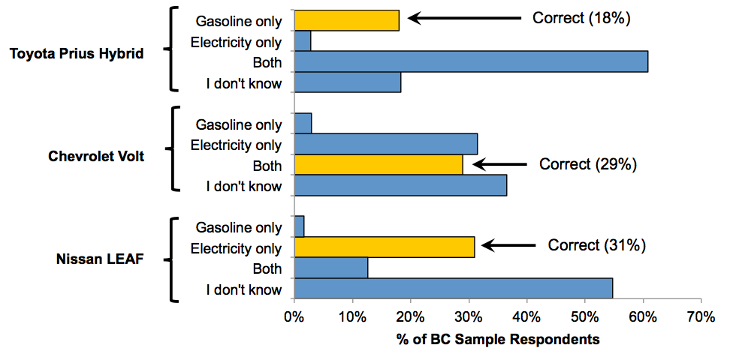
Mainstream awareness is low
“How is each of the following vehicle fueled?
Source: Axsen, Goldberg and Bailey (2016), Transportation Research Part D

Slide 10
A qualitative exploration of consumer perceptions
(and misperceptions)

Slide 11
Research Objectives
PEV technologies: PHEV and BEV
Vehicle-grid-integration
1. Assess participant knowledge of PEV technologies:
Awareness: conscious that a technology exists.
Familiarity: being acquainted with its details.
Understanding: comprehension of operation and implications
2. Identify participants’ perceptions:
Functional: what it does
Symbolic: what message it conveys
Societal: what it means for society
Notes:
Utility controlled charging (UCC) could be an important method to control the timing of PEV charging to reduce environmental impacts, increase the use of renewable energy, and potentially reduce grid costs. We explore respondent acceptance of various UCC programs, finding that:
Among Mainstream (NVOS) respondents:
Awareness and understanding of electricity sources and the idea of UCC is very low.
Once explained, there is general openness to UCC programs, where probability of enrollment in such a program is higher with decreased electrical bills, increased access to renewable electricity, and increased “guaranteed minimum charge” or more charge each morning.
There is significant heterogeneity among respondent that are “Pro-UCC” (79%), where 34% are motivated by guaranteed minimum charge or more charge, 28% are motivated by cost savings, and 17% are motivated by increased renewable electricity.
Interviews indicate that some see linking PEVs to green electricity as “natural,” but there is concern regarding loss of control and lack of trust in the utility.
Among PEV Pioneer (PEVOS) respondents:
UCC acceptance is much higher relative to NVOS respondents, where PEVOS respondents are willing to pay 50% more for guaranteed minimum charge, and 4 times more for increased renewables
Two-thirds of respondents are clearly “Pro-UCC”; the remaining third places a lower value on UCC and is much more sensitive to decreases in guaranteed minimum charge.
Interviews indicate that motives for UCC enrollment are primarily related to supporting the environment (renewables) or supporting technology development.

Slide 12
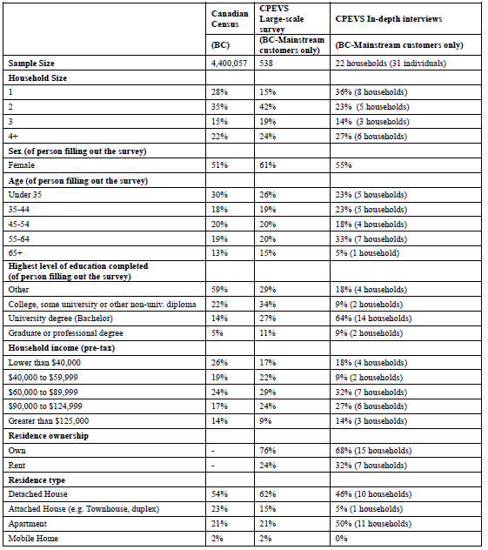
Interviewing a sub-set of survey respondents:
Purposive sampling
22 households
31 individuals

Slide 13
Consumer awareness
(or lack thereof)

Slide 14
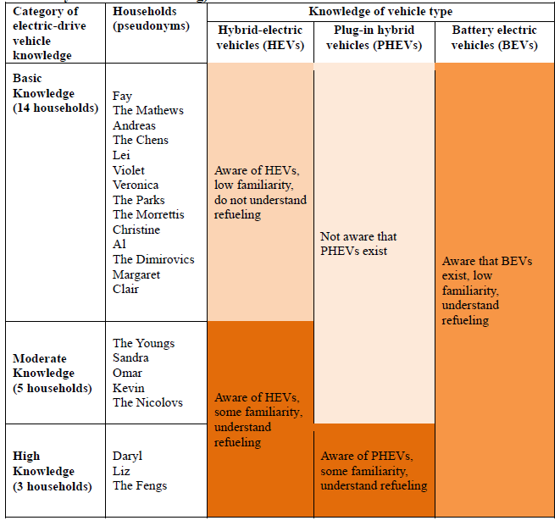
Less
Knowledge
More
Knowledge

Slide 15
Mainstream has low awareness…
The majority expressed confusion about PEVs:
    “Is the Leaf electric or is it hybrid?” – Mr. Chen
    “[W]hat’s the deal here? You don’t plug this in, the hybrid?” - Clair
    “there might be a little bit of difficulty in recharging [a hybrid] if you're going on a long journey.” – Mr. Mathews
And confusion about vehicle-grid integration.
    “That gets pretty complicated when you start talking about [balancing the grid].” - Andreas
    “[seems] futuristic” – Clair
    “Oh god!” – Christine (in confusion)
Source: Axsen, Langman & Goldberg (Under Review), Energy Research & Social Science

Slide 16
Categorizing consumer perceptions

Slide 17
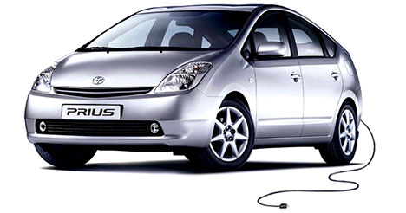
Consumers are varied in their motives…
Functional
Symbolic
Private
Societal
Source: Axsen and Kurani (2012), Environment and Planning A

Slide 18
Consumers are varied in their motives…
Functional
Symbolic
  What it does
  for you
  What it
  represents
Source: Axsen and Kurani (2012), Environment and Planning A

Slide 19
Consumers are varied in their motives…
Functional
Symbolic
  What it does
  for you
  What it
  represents
Private
  What it does
  for society
What it says
to society
Societal
Source: Axsen and Kurani (2012), Environment and Planning A

Slide 20
Perceptions regarding PEVs
Functional
Symbolic
(+) Saving money (19)
(+) PHEV range (12)
(+) Home charge (3)
(-) BEV range (12)
(-) Charge inconvenience (15)
(-) Maintenance? (11)
“I like the Volt type because I don't want to be stranded … if I have to stop by a gas station, I stop by a gas station.” – Mr. Feng
Private
Societal
“Well, there's not a chance in hell you're going to Kamloops.” - Al
“Or road trips or something – do you literally take your family and you sit there and youcharge your car and try and entertain your kids for three hours?” – Christine

Slide 21
Perceptions regarding PEVs
Functional
Symbolic
(+) Saving money (19)
(+) PHEV range (12)
(+) Home charge (3)
(-) BEV range (12)
(-) Charge inconvenience (15)
(-) Maintenance? (11)
Private
(-) PEVs are “Strange” (9)
Societal
“It just seems kind of… a little bit kind of out there.” – Mrs. Chen

Slide 22
Perceptions regarding PEVs
Functional
Symbolic
(+) Saving money (19)
(+) PHEV range (12)
(+) Home charge (3)
(-) BEV range (12)
(-) Charge inconvenience (15)
(-) Maintenance? (11)
Private
(-) PEVs are “Strange” (9)
(+) Cuts pollution (19)
(-) Toxic batteries? (4)
Societal
“I imagine environmentally they're probably really good.” – Mr. Chen
“[W]hat do you do with the battery afterwards? … to recycle these things is just a bitch.” – Al

Slide 23
Perceptions regarding Vehicle-grid-integration (VGI)
Functional
Symbolic
(-) Battery impacts? (3)
(-) Loss of Control (9)
Private
“[I would] want to make sure that that's not hurting my battery.” – Mr. Feng
Societal
“I don't like having no control over… knowing how much the car's gonna be
[charged]” – Veronica“

Slide 24
Perceptions regarding Vehicle-grid-integration (VGI)
Functional
Symbolic
(-) Battery impacts? (3)
(-) Loss of Control (9)
Private
(-) Requires trust (7)
(-) Loss of Control (9)
Societal
“Like, what if I had all these plans… and I thought I was getting 80% charge and then they gave me 50?”
– Christine

Slide 25
Perceptions regarding Vehicle-grid-integration (VGI)
Functional
Symbolic
(-) Battery impacts? (3)
(-) Loss of Control (9)
Private
(-) Requires trust (7)
(-) Loss of Control (9)
“We already get wind… and if you can make something work with something
that's already there that isn't harming the Earth, why not?” – Liz
(+) Cuts pollution (~10)
(+) Renewables and cars
go together” (3)
(-) Negative impacts of renewable (~10)
Societal
“…having an electric car and the green electricity, I mean you're walking the
walk” – Liz
“[T]hey were saying it might affect some birds” – Mr. Feng

Slide 26
Implications from “reflexive” inquiry…
For researchers:
…include the consumer.
…use methods that give the consumer “reflexive space”.
…interpret consumer research carefully.
For policymakers:
…awareness and confusion are real barriers.
…Mainstream is not very eager to overcome barriers.
…education campaigns might help…
…but biggest impact is to get vehicles “out there”.
Notes:
Utility controlled charging (UCC) could be an important method to control the timing of PEV charging to reduce environmental impacts, increase the use of renewable energy, and potentially reduce grid costs. We explore respondent acceptance of various UCC programs, finding that:
Among Mainstream (NVOS) respondents:
Awareness and understanding of electricity sources and the idea of UCC is very low.
Once explained, there is general openness to UCC programs, where probability of enrollment in such a program is higher with decreased electrical bills, increased access to renewable electricity, and increased “guaranteed minimum charge” or more charge each morning.
There is significant heterogeneity among respondent that are “Pro-UCC” (79%), where 34% are motivated by guaranteed minimum charge or more charge, 28% are motivated by cost savings, and 17% are motivated by increased renewable electricity.
Interviews indicate that some see linking PEVs to green electricity as “natural,” but there is concern regarding loss of control and lack of trust in the utility.
Among PEV Pioneer (PEVOS) respondents:
UCC acceptance is much higher relative to NVOS respondents, where PEVOS respondents are willing to pay 50% more for guaranteed minimum charge, and 4 times more for increased renewables
Two-thirds of respondents are clearly “Pro-UCC”; the remaining third places a lower value on UCC and is much more sensitive to decreases in guaranteed minimum charge.
Interviews indicate that motives for UCC enrollment are primarily related to supporting the environment (renewables) or supporting technology development.

Slide 27
Extras

Slide 28
Important barriers to PEV sales
“Constrained” forecast,
without substantial policy
~1% market share
Source: Wolinetz and Axsen (forthcoming)

