Slide 1
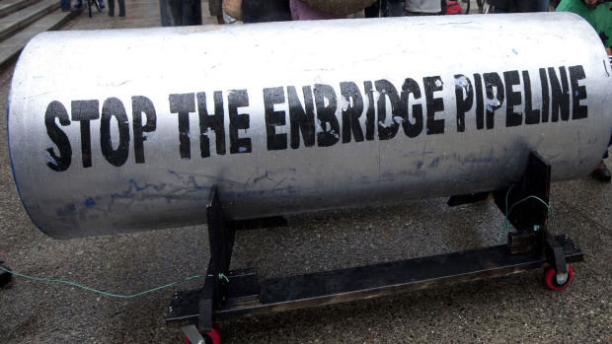
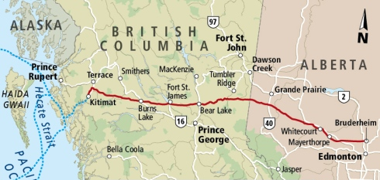
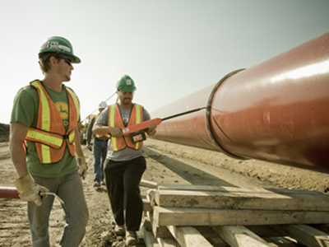

Media framing of unconventional fossil fuels:
The absence of climate dialogue in Canada’s Northern Gateway Project
Paper: Nichole Dusyk, Jonn Axsen & Kia Dullemond
Presenter: Dr. Jonn Axsen, Associate Professor,
Director, Sustainable Transportation Action Research Team (START),
Simon Fraser University
January 9, 2017

Slide 2
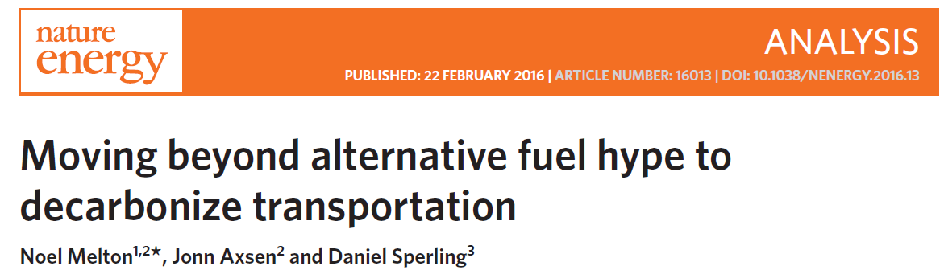
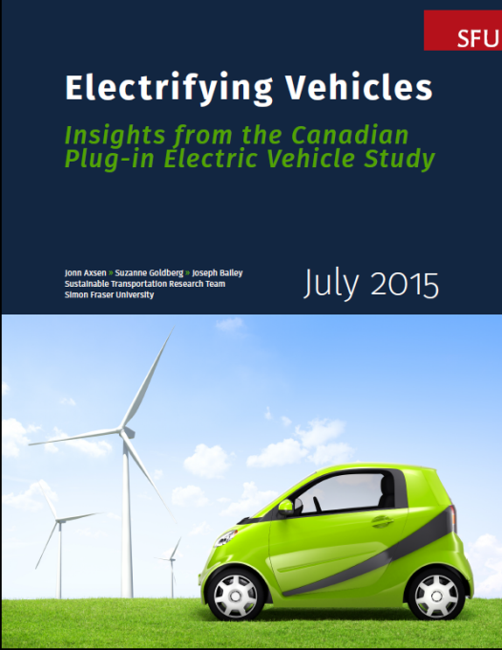
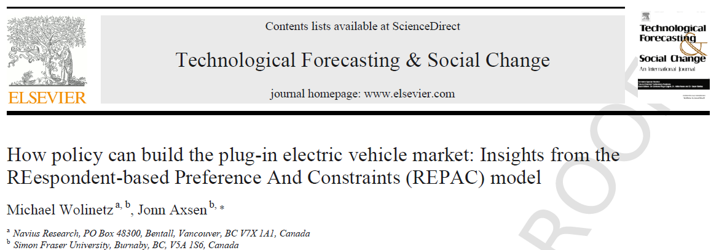
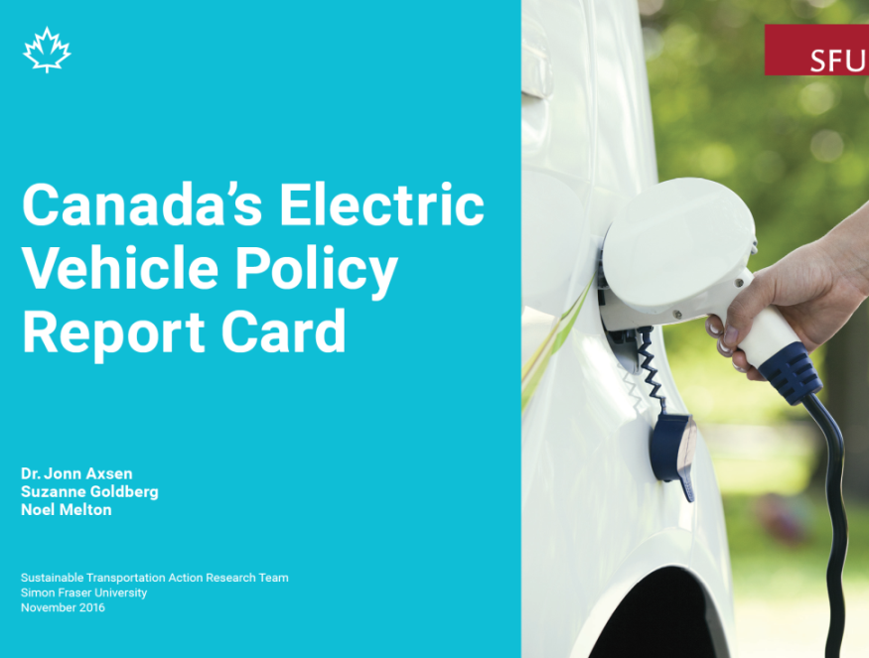
Sustainable
Transportation
Action Research
Team (START)

Slide 3
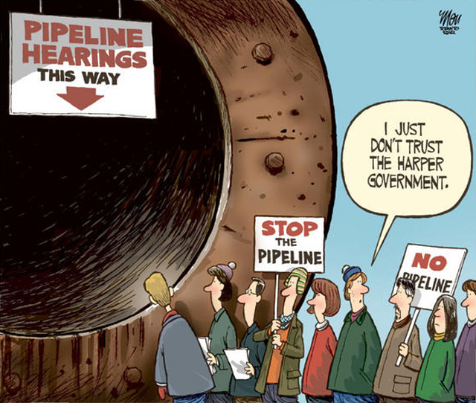
Pipelines, politics, and society

Slide 4
Controversy
and
unconventional fossil fuels

Slide 5
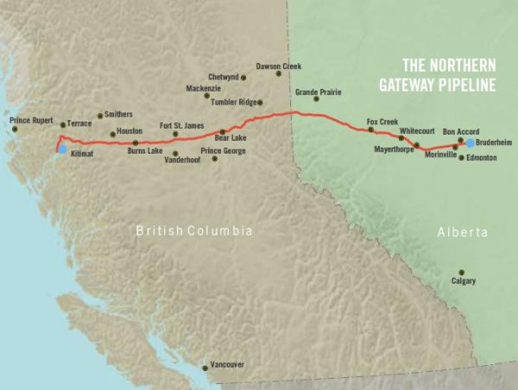
NGP: Proposed to transport bitumen 1,172 km from Alberta oil sands to Northern BC Coast

Slide 6
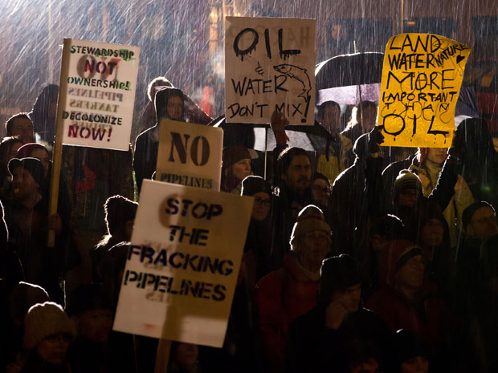
Controversy over new fossil fuel extraction
Benefits:
Industry
Job creation
Economy
Local risks:
Pipeline spills
Tanker spills
Land rights
Air quality
Water quality
Ecosystems
Global risks:
Climate change

Slide 7
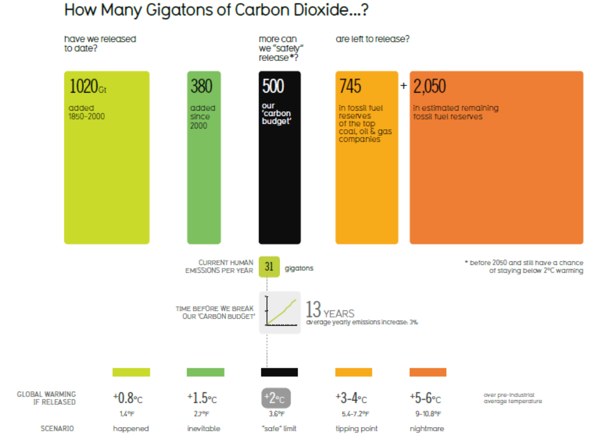
Carbon budget: we can only burn so much more fossil fuel to stay within 2°C limit
Source: Nature, 2012

Slide 8
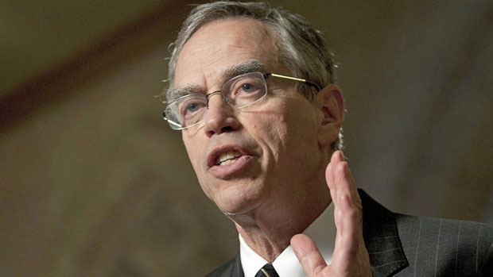
Federal rhetoric…
Joe Oliver, Natural Resource Minister:
  “There are environmental and other radical groups that would seek to block this opportunity to diversity our trade…
  …[these groups] threaten to hijack our regulatory system to achieve their radical ideological agenda.”
  - CBC news, January 9, 2012

Slide 9
What do Canadian citizens think about the pipeline?

Slide 10
Substantial regional variation in support: Highest resistance in British Columbia
Statement: “I support the Enbridge Northern Gateway Project”
Alberta
Central
BC
Atlantic
Strongly
Agree
Agree
Disagree
Strongly
Disagree
Source: Axsen (2014), Energy Policy

Slide 11
Alberta perceives more economic benefits;
BC perceives more environmental risks
Canadian Oil Sands
The pipeline project…
* Chi-square association at 99% confidence level
Source: Axsen (2014), Energy Policy

Slide 12
Substantial within-region variations
in support among value segments
BC sample (n = 813)
AB sample (n = 508)
Traditional
Self-oriented
Traditional
Unengaged
Self-oriented
Unengaged
Strongly
Agree
Agree
Dis-
agree
Strongly
Dis-
agree
Multi-valued
Mildly aware
Multi-valued
Strong enviro.
Mildly aware
Strong enviro.
Statement: “I support the Enbridge Northern Gateway Project”
Source: Axsen (2014), Energy Policy

Slide 13
Media analysis:
How is the Northern Gateway Pipeline “framed” in Canadian media (2008-2014)

Slide 14
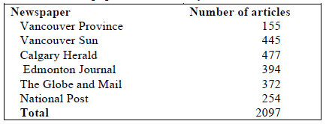
The study
Research objectives:
Characterize media framing
Identify regional difference
Explore “environmental” frame
Method: 2097 print articles
Socio-political evaluation of energy deployment (SPEED) framework (Stephens et al. 2008)
Economic
First Nations
Technological
Health & Safety
Socio-cultural
Political
Environmental (Climate, coastal, terrestrial, other)

Slide 15
Articles by year: 2012 peak in political activity

Slide 16
Most focus on economic benefit and environmental risks
“As a resource driven economy, there's no question that
Canada needs access to tidewater and the project is going to generate billions in terms of spinoffs, thousands of jobs and benefits to communities”
(Globe and Mail A246)
“…the most critical element of the proposal is the risk it poses. First, pipelines do leak…. tis northern pipeline would cross a thousand streams and rivers, including two of Canada's most important salmon-bearing watersheds,.”
(Province A178)

Slide 17
Project feasibility statements tend to be negative; little regional difference

Slide 18
Little difference in regional focus on benefits and risks

Slide 19
Mentions of environmental risks are mostly general or “spill” related; little mention of climate change
“The proposed line has prompted fierce opposition in B.C….about potential oil spills and increased greenhouse gas emissions from expanding the oil sands.” (Herald A119)

Slide 20
Some Take Home Points
Strong media focus on economy versus environment
Little regional variation in media frames, although citizen support and opposition strongly vary
Media coverage largely ignores climate change impacts—environmental groups could better invoke climate framing
Much has changed post-2014…
  New national government (Trudeau) in 2015
  Serious climate policy announced, including carbon pricing
  Northern Gateway pipeline rejected
  …but Trans-mountain pipeline (Kinder-Morgan) approved
  “Eco-modernization” frame, but not “carbon budget”

