Slide 1

Visions of
grid-connected
vehicles:
What is the goal and
how do we get there?
Facilitators:
Jonn Axsen
Associate Professor, Simon Fraser University
Director, Sustainable Transportation Action Research Team (START)
Nicolò Daina
Research Associate, CTS, Imperial College London
January 8, 2017, Washington DC

Slide 2
Vehicle-Grid Integration (VGI)
A definition: efforts to intelligently plan the linkages and synergies between the transportation and electricity sectors.
VGI visions can include different ideas of:
  Flow
    V1G: unidirectional flow (control, delay, optimize charging)
    V2G: bidirectional flow (vehicle can charge, store, discharge)
  Mechanisms of engagement
    Time-of-use pricing, opt-in programs, revenue sharing, education
  Vehicle types
    Plug-in hybrid (PHEV) and “pure” battery electric (BEV)
  Vehicle classes
    Light-duty, medium-heavy duty, private, passenger, freight, car-sharing, automation

Slide 3
Agenda
1:30 Welcome and introduction by Drs. Jonn Axsen and Nicolò Daina
1:35 Session 1: VGI visions for the climate, society and consumers
Facilitated by Jonn Axsen
  Benjamin Sovacool, University of Sussex, United Kingdom
  Patrick Jochem, Karlsruhe Institute of Technology, Germany
  Nicolò Daina, Imperial College London, UK
  Michael Wolinetz, Navius Consulting, Canada
  Jeremy Michalek, Carnegie Mellon, USA
2:55 Break (15 min)
3:10 Session 2: VGI visions for business: perspective and prospects
Facilitated by Nicolò Daina
  Willet Kempton, University of Delaware, USA
  Timothy Lipman, UC Berkeley, USA
  Scott Baker, PJM Interconnection, USA
  Gegory Poliasne, Nuvve, USA
  Adam Langton, BMW North America, USA
  jonn Axsen, Simon Fraser University, Canada,
4:30pm end

Slide 4
Vehicle-Grid Integration (VGI)
This workshop encourages a “socio-technical” perspective, including technical, economic, political, environmental and behavioural aspects.
We ask speakers to address these questions:
  What are the benefits and risks of different VGI visions?
  What vision(s) is best for society?
  What policies (if any) are required to get there?
  Is there a business case for grid-integrated vehicles?
  What is the role of consumer behaviour?

Slide 5
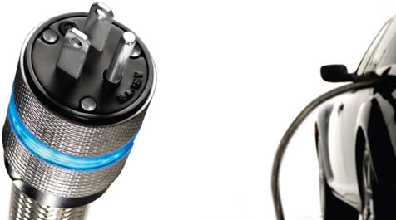

Consumer perceptions of VGI:
Will the Mainstream 'get it’?
Jonn Axsen
Associate Professor, Simon Fraser University
Director, Sustainable Transportation Action Research Team (START)
January 8, 2017
VGI Workshop
TRB 2017
Washington DC

Slide 6
My VGI focus and insights…
Vision of focus:
  Target: Deep GHG reductions (80% by 2050), “reasonable” costs, strong policies needed to get there
  I’ve been focused more privately owned passenger vehicles
To engage the “Mainstream” consumer:
  Keep it simple: vehicles and VGI program

Slide 7
Big differences between PEV “Pioneers” and the potential “Mainstream”
PEV “Pioneers”
(early buyers)
Potential
“Early Mainstream”
PEV buyers
New vehicle buyers
“Later Mainstream”?
Passenger Vehicle Owners
Notes:
Introduce BC PEVOS and CPEVS or visualize it here. Talk about the CPEVS
--- Brief synopsis of the CPEVS
Survey = 538, 40% (215) were EM; 60% (323) were other
-- EV’s represent less than 1% of new vehicle sales. New vehicle sales represent X% of total register personal vehicles which is over 2.5 million.

Slide 8
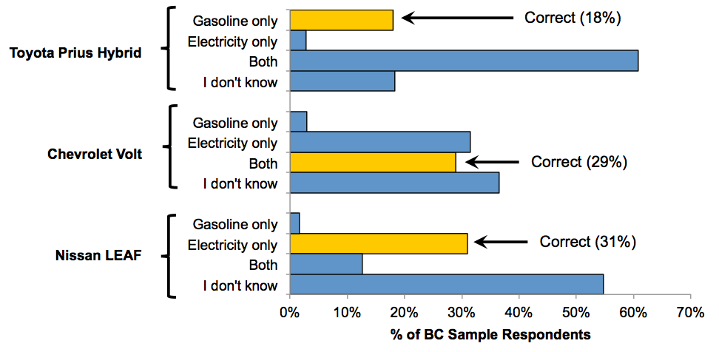
Mainstream has low awareness…
…of PEVs
(Hybrid)
(Plug-in
Hybrid)
(Pure
electric)
Source: Axsen, Goldberg and Bailey (2016), Transportation Research Part D

Slide 9
Mainstream has low awareness…
…of VGI
Semi-structured interview with 21 “Mainstream” households in Metro Vancouver
The majority of households (14 or 21) had trouble understanding the idea of VGI:
    “That gets pretty complicated” -- Andreas
    “[seems] futuristic” – Clair
    “Oh god!” – Christine (in confusion)
Source: Axsen, Langman & Goldberg (Under Review), Energy Research & Social Science

Slide 10
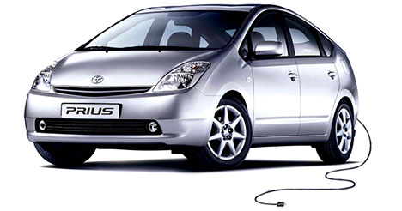
Consumers are varied in their motives…
Functional
Symbolic
Private
Societal
Source: Axsen and Kurani (2012), Environment and Planning A

Slide 11
Consumers are varied in their motives…
Functional
Symbolic
  What it does
  for you
  What it
  represents
Source: Axsen and Kurani (2012), Environment and Planning A

Slide 12
Consumers are varied in their motives…
Functional
Symbolic
  What it does
  for you
  What it
  represents
Private
  What it does
  for society
What it says
to society
Societal
Source: Axsen and Kurani (2012), Environment and Planning A

Slide 13
Different consumer segments have different priorities for VGI enrollment
Early Mainstream
PEV Pioneers
Privacy concerns
Negative WTP for green
Source: Bailey and Axsen (2016), Transportation Research A

Slide 14
Simulations of VGI enrollment rates vary by program design
Early PEV Mainstream Enrollment
PEV design
Baseline (No renewables, no savings)
53%
20% Bill Savings
100% GMC
70%
20% Bill Savings
80% GMC
61%
100% Renewables
100% GMC
57%
100% Renewables
80% GMC
46%
Source: Bailey and Axsen (2016), Transportation Research A
Notes:
Black Lines Denote Standard Error Estimated Using the Delta Method.
See TRPTA PDF for more information.

Slide 15
VGI and the potential
“Early Mainstream” PEV buyers
Mainstream consumers are…
Generally confused
Once explained, generally supportive (especially with renewables)
…but when set of as a tradeoffs (choice experiment), cost and convenience attributes win
“Trust” will be an important factor for some
Notes:
Utility controlled charging (UCC) could be an important method to control the timing of PEV charging to reduce environmental impacts, increase the use of renewable energy, and potentially reduce grid costs. We explore respondent acceptance of various UCC programs, finding that:
Among Mainstream (NVOS) respondents:
Awareness and understanding of electricity sources and the idea of UCC is very low.
Once explained, there is general openness to UCC programs, where probability of enrollment in such a program is higher with decreased electrical bills, increased access to renewable electricity, and increased “guaranteed minimum charge” or more charge each morning.
There is significant heterogeneity among respondent that are “Pro-UCC” (79%), where 34% are motivated by guaranteed minimum charge or more charge, 28% are motivated by cost savings, and 17% are motivated by increased renewable electricity.
Interviews indicate that some see linking PEVs to green electricity as “natural,” but there is concern regarding loss of control and lack of trust in the utility.
Among PEV Pioneer (PEVOS) respondents:
UCC acceptance is much higher relative to NVOS respondents, where PEVOS respondents are willing to pay 50% more for guaranteed minimum charge, and 4 times more for increased renewables
Two-thirds of respondents are clearly “Pro-UCC”; the remaining third places a lower value on UCC and is much more sensitive to decreases in guaranteed minimum charge.
Interviews indicate that motives for UCC enrollment are primarily related to supporting the environment (renewables) or supporting technology development.

Slide 16
Extras

Slide 17
Mainstream: everybody loves “Green”
Oppose
Support
Source: Bailey and Axsen (2016), Transportation Research A
Notes:
The question was:

Slide 18
All groups: Won’t accept much inconvenience
Minimum charge on any
given morning.
Percentage of respondents that would accept this GMC every day
Maximum amount that might be “missing” due to VGI
Mainstream Pioneers
90% Charged In a morning
43%
37%
10%
75% Charged In a morning
18%
18%
25%
6%
3%
50% Charged In a morning
50%
Source: Bailey and Axsen (2016), Transportation Research A
Notes:
How do they feel about the GMC component?

Slide 19
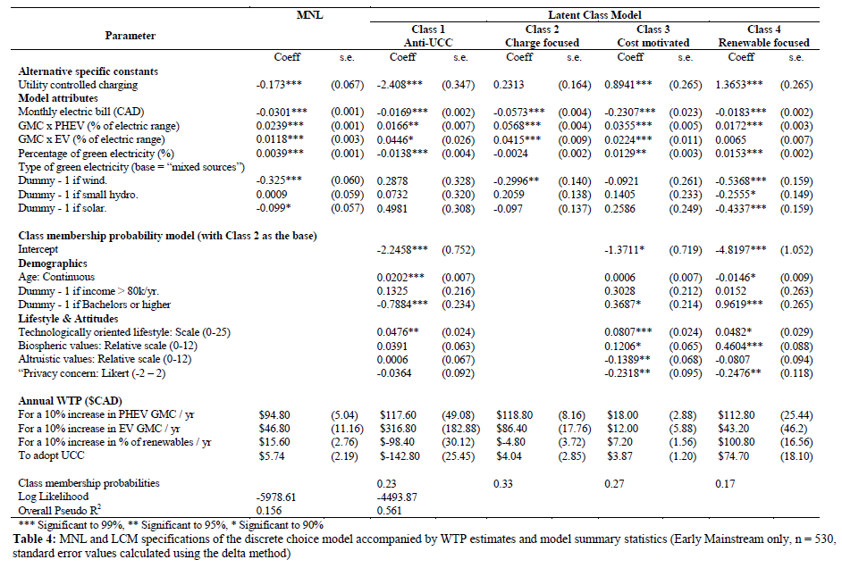
Latent class model results (Mainstream sample)

Slide 20
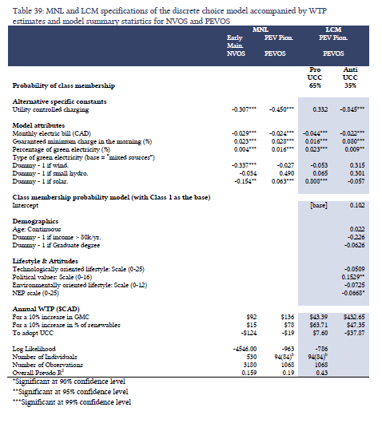
Mainstream and Pioneer Choice models

Slide 21
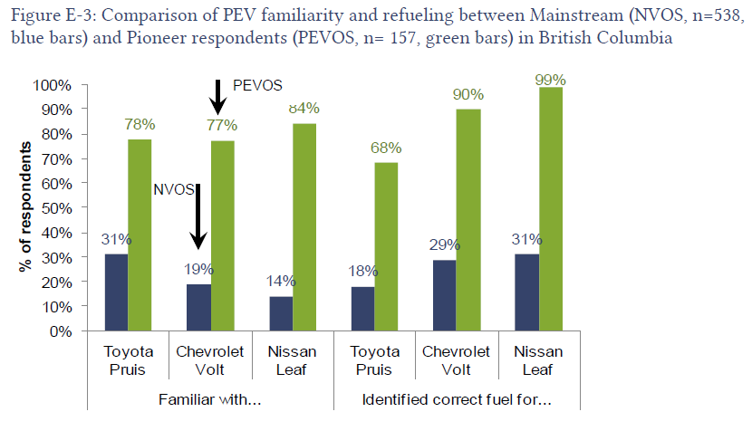
Comparing Pioneer and Mainstream awareness of PEVs

Slide 22
Important barriers to PEV sales
“Constrained” forecast,
without substantial policy
~1% market share
Source: Wolinetz and Axsen (forthcoming)

Slide 23
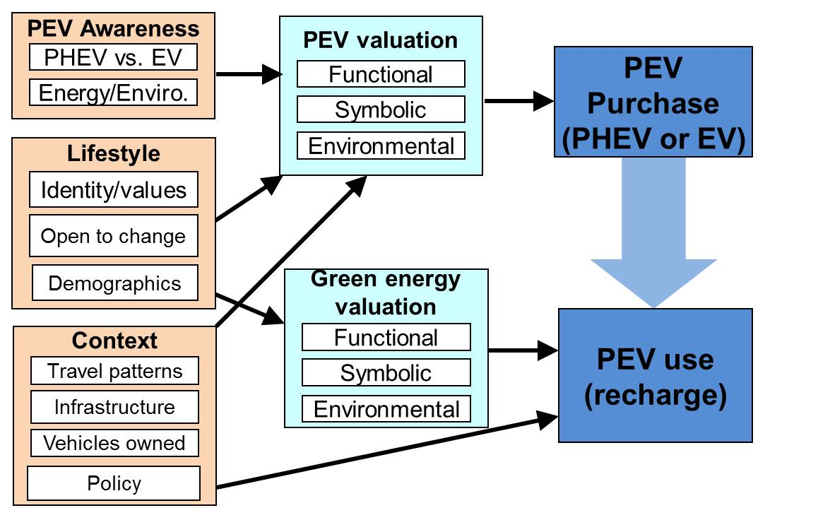
A framework for consumer engagement with VGI
Source: Axsen et al. (2015), Electrifying Vehicles

Slide 24
Two perspectives
1) PEVs and VGI are inherently awesome and will dominate, no problem!!!
2) PEVs and VGI have some advantages, but strong policy is needed to overcome:
  Negative externalities (GHGs, air pollution)
  Innovation externalities (R&D spillovers)
  Transformative failures (directionality failure and reflexivity failure)
Source: Melton, Axsen & Sperling (2016), Nature Energy

